Slide 1
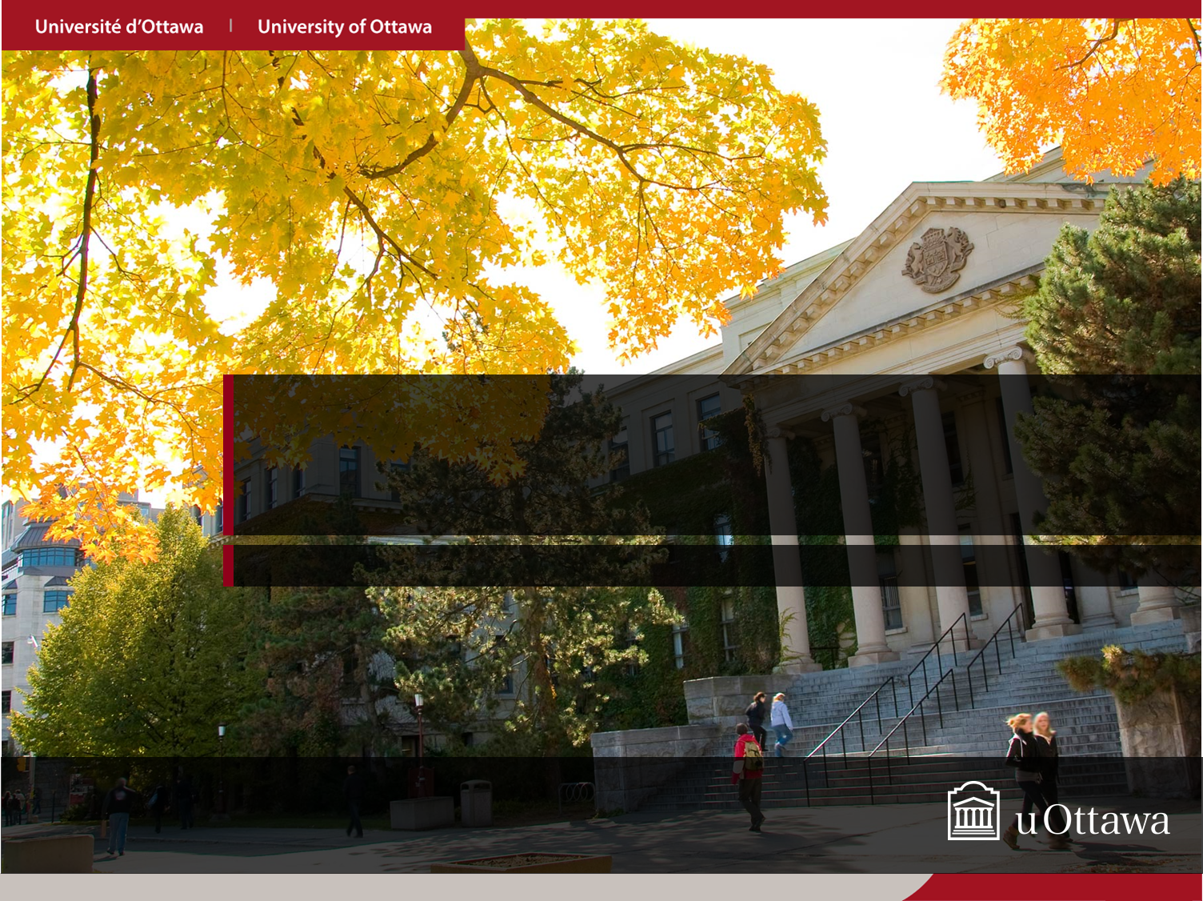
Optimising Existing Software with Genetic Programming (By William B. Langdon and Mark Harman)
Presented by: Aishwarya Manapuram
CSI5137[B] AI-Enabled Software Verf. & Test Seminar (Oct- 10- 2023)

Slide 2
Agenda
Introduction
Problem Statement
Solution (GISMOE)
MOTIVATION
Implementation
Evaluations
Results
Critique
Conclusion
References

Slide 3
Introduction
Optimizing existing software means making improvements to the software to enhance its performance, efficiency, and/or functionality. Optimization aims to make the software run faster, use fewer resources (such as memory or CPU), and deliver a better user experience.
The paper introduces the concept of genetic improvement, which is the process of automatically improving a software system's behavior using genetic programming.

Slide 4
Problem Statement
The authors of this paper aim to show that genetic programming techniques can be applied to real-world, highly complex existing software systems to enhance non-functional properties of a system, such as execution time and resource consumption, while maintaining or improving its functional properties.
Real-World, Complex Software: Bowtie2, a widely-used DNA sequencing system with approximately 50,000 lines of C++ code, as their target system.
Functional Correctness: While optimizing non-functional properties, the authors also aim to ensure that the evolved software maintains or enhances its functional correctness. The new code should produce results that are at least as good, if not better, than the original code.

Slide 5
Solution
The goal of GI is to automate as much of the improvement process as possible. Thus, new implementations can be discovered by an evolutionary process, rather than being hand-crafted by human programmers.
Automated Test Oracle: The genetic improvement process relies on a set of test cases obtained from running the original system. An automated test oracle is used to compare the output of the original and evolved code.

Slide 6
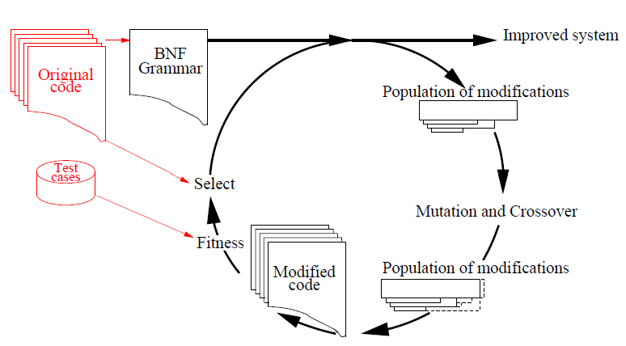
Solution - GISMOE
Major components of GISMOE approach
Left: system to be improved and its test suite.
Right: genetic programming optimises modifications which originate from a grammar that describes the original system line by line.
Each generation mutation and crossover create new modifications. Each modification’s fitness is evaluated by applying it to the grammar and then reversing the grammar to get a new variant of the system.
Each modified system is tested on a randomised subset of the test suite and its answers and resource consumption compared to that of the original system. Modifications responsible for better systems procreate into the next generation.
GISMOE (Genetic Improvement
of Software for Multiple Objective Exploration)

Slide 7
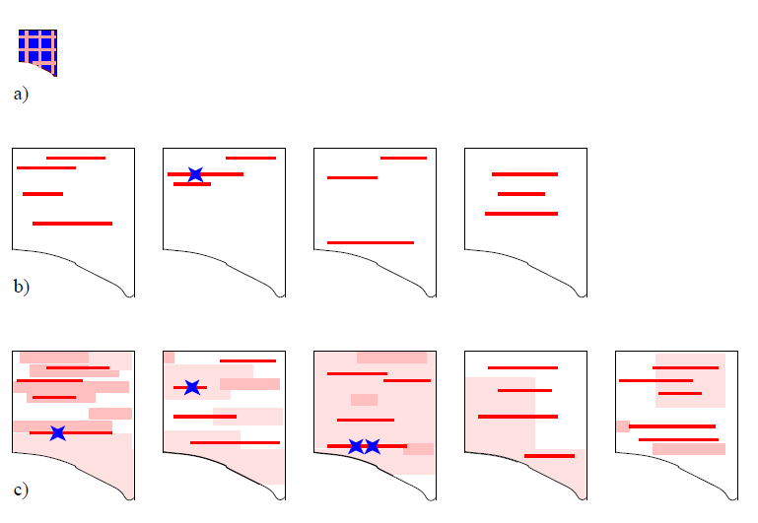
Solution - GISMOE
GISMOE (Genetic Improvement
of Software for Multiple Objective Exploration)
a) Initial approaches considered whole program equally (shaded). They update code (dark shading) which may be throughout the single source file.
b) Bug fixing. Genetic programming is directed to parts of code needing fixing (shaded) and the bugfix (star) is small.
c) GISMOE: Evolution is directed to used and heavily used code (light shaded, shaded, heavily shaded) several lines of code may be updated (stars).

Slide 8
MOTIVATION - Bowtie2
Why Bowtie2 as target system?
Ans: Bowtie2 is a complex bioinformatics tool used for aligning DNA sequences, and it is widely used in genomics research. Bowtie2 system consists of 50 000 lines of C++ spread over 50 main system modules and 67 header files (plus documentation, scripts and support modules).
Bowtie2 is considered an improved and more efficient version of its predecessor, Bowtie1. Bowtie2, like any software, has known issues, bugs, and performance bottlenecks.
Genetic programming techniques provide an opportunity to automatically evolve improved versions of the software, addressing known issues and potentially discovering new ways to enhance its functionality.

Slide 9
Implementation: GISMOE – for Bowtie2 program
OVERVIEW:
Various techniques and approaches are used to achieve genetic improvement in GISMOE:
output binning
semantic improvement
sensitivity analysis
operator choice
grammatical representation
local search.

Slide 10
Implementation: GISMOE – for Bowtie2 program
OUTPUT BINNING: O-Bins (Output Bins for Test Cases):
O-Bins are used to partition the available test cases. The motivation behind this partitioning is to capture the varying levels of difficulty associated with test cases.
O-Bins allow the selection of test cases from different bins, ensuring a mix of difficult and less demanding tests for fitness evaluation. This helps in assessing both functional and non-functional properties of the code.

Slide 11
Implementation: GISMOE – for Bowtie2 program
SENSITIVITY ANALYSIS:
Sensitivity analysis is applied to identify the parts of the system that have the greatest impact on the non-functional property of interest (e.g., execution time).
This analysis helps prioritize which parts of the system should be improved during the evolutionary phase.
The weighting of lines of code takes into account:
how frequently they are executed and
how their use scales with the difficulty of the problem.

Slide 12
Implementation: GISMOE – for Bowtie2 program
REPRESENTATION OF THE SYSTEM TO BE EVOLVED:
Template based Evolution: The existing program serves as a template for its own improvement.
A specialized "one-sentence" Backus-Naur Form (BNF) grammar is automatically created from the program's source code.
Here Fundamental structures (classes, types, functions, & data structures) remain intact. Block structure is maintained i.e. the open/close brackets remain the same.
program's source code
BNF grammar
Notes:
While genetic evolution has the freedom to make changes to the code, it is constrained by this template. The template ensures that fundamental program structures such as classes, types, functions, and data structures remain intact. It also maintains the block structure of the program, including opening and closing brackets. Evolution can modify the contents of functions, data structures, and variables, but it cannot change their fundamental structure.

Slide 13
Implementation: GISMOE – for Bowtie2 program
Code Compilation: To ensure that evolved code is syntactically valid, a specialized BNF grammar is used to eliminate parse errors.
Reusing Code Fragments: Instead of allowing GP complete freedom to generate entirely new code, the approach focuses on reusing code that has already been written within the program being improved. Human-written code often contains repeated lines or fragments. So, reusing existing code fragments yield significant improvements in the software.
Notes:
Reusing Code Fragments: Instead of allowing GP complete freedom to generate entirely new code, the approach focuses on reusing code that has already been written within the program being improved. This "cut and paste" approach involves removing lines of code (cutting) and copying them to other places in the program (pasting). This approach leverages the observation that human-written code often contains repeated lines or fragments. Reusing existing code fragments has been found to yield significant improvements in the software.

Slide 14
Implementation: GISMOE – for Bowtie2 program
Representation of a Genetically Improved Variant: Each genetically improved variant is represented as an ordered list of changes to be made to the program's Backus-Naur Form (BNF) grammar. Changes include deleting lines of code, replacing lines with others, or inserting new lines.
Selection: Up to half of the current population of genetic variants is selected based on their fitness (effectiveness). Variants that didn't compile or didn't surpass the original code's performance are excluded.

Slide 15
Implementation: GISMOE – for Bowtie2 program
Mutation: Genetic variants are mutated by appending new grammar modifications to their lists of changes. The line to be mutated is chosen based on sensitivity analysis and test case execution.
Crossover: Crossover combines two genetic variants by concatenating their lists of changes.
Post Processing Solution Cleanup: After genetic evolution, evolved programs can be bloated with unnecessary changes. A hill climbing strategy is used to minimize the size of the ordered list of changes.

Slide 16
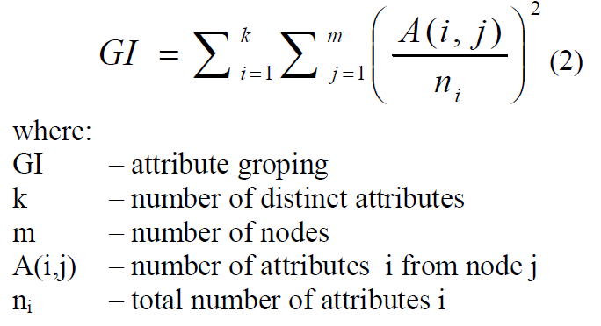
Evaluations GISMOE – for Bowtie2 program
Consider a table with
-n entries, network with k nodes.
-The chromosome is coded as an array with n elements, each having a value between 1 and k-1. The fitness function has to include the following optimum criteria: i) grouping of entries with the same attributes, as well as ii) distributing them in an equal fashion between a minimum number of nodes.

Slide 17
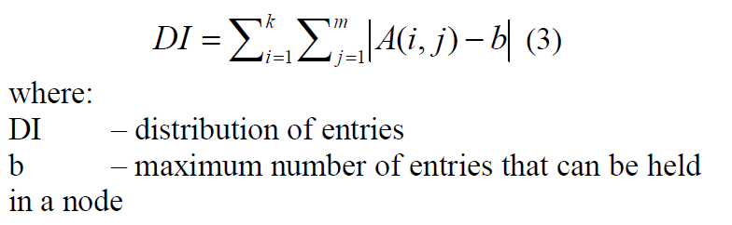
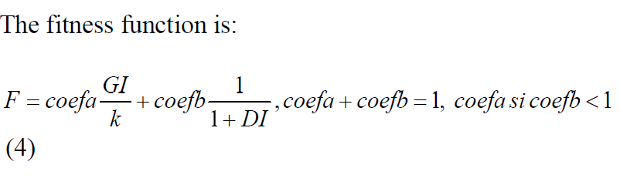
Evaluations GISMOE – for Bowtie2 program
-Distribution of entries with the same attributes between a minimum number of nodes if done using the following formula:
- coefa, coefb are 2 constants; coefa, coefb are chosen based on the importance given to each optimum criterion.

Slide 18
Results - for Bowtie2 program
The Smith-Waterman algorithm is used as an oracle to compare the results of Bowtie2 against the human genome and Solexa DNA sequences from the 1000 Genomes Project.
Here are the main results and observations from GI process:
Fitnesss Test: modified system takes fewer instructions. Small increase in Smith-Waterman score.
39 modules containing
20,000 Loc. These were automatically translated line for line into a BNF grammar of 19 949 rules.
sensitivity analysis 72% of lines are not used but 80 lines are run more than a million times.
Bowtie2 original
Program (50,000 lines of C++)

Slide 19
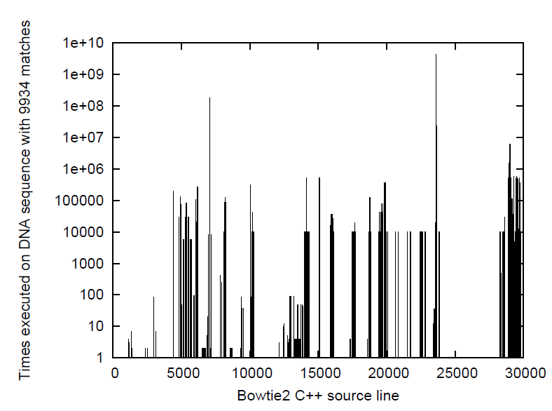
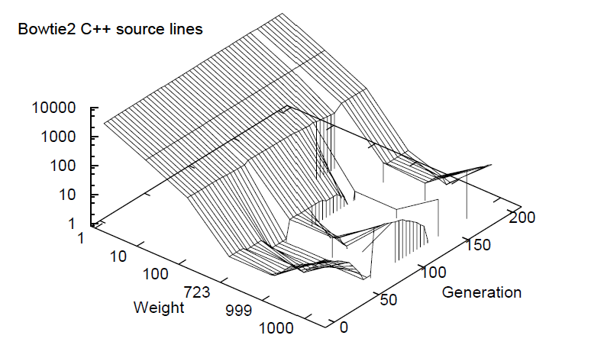
Results - for Bowtie2 program
When Bowtie2 finds many matches of the distribution of the number of times each Bowtie2 C++ source line is used. 72% of lines are not used but 80 lines are run more than a million times
Evolution of distribution of weights. Initial GP population (generation 0) at left. Note fall in proportion of higher weights as population evolves to mutate highly used C++ lines and then recovery as it (partially) resets in generations 68 and 168. (Note non-linear scales. To reduce clutter, data plotted only every 4th generation.)

Slide 20
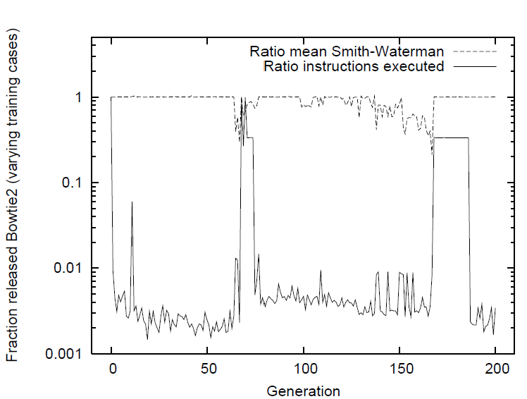
Results - for Bowtie2 program
Evolution of performance: In the last generation the best uses 290 times fewer C++ statements than the original code. In most generations there is a small improvement in mean Smith-Waterman score (dashed line)

Slide 21
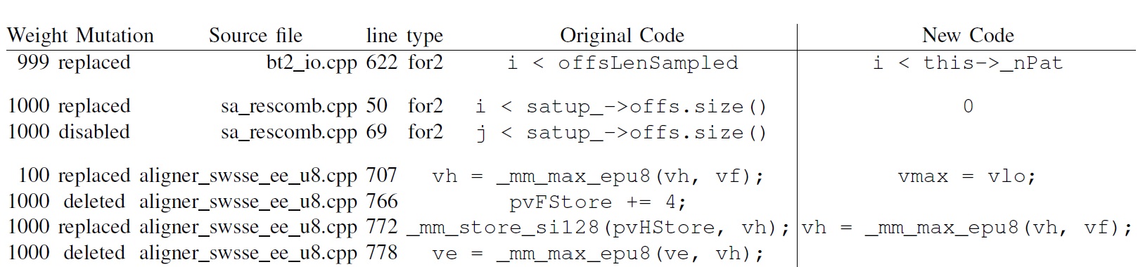
Results - for Bowtie2 program
Performance: The evolved Bowtie2 version is tested on a hold-out dataset, and the results show that it is on average 74 times faster than the original version.

Slide 22
Critique
Soundness: do you see any flaws in the paper?
The paper demonstrates soundness in its approach to applying genetic programming (GP) to evolve and optimize software. It follows a systematic process and provides a clear methodology for evolving code.
The paper could provide more insights into how the choice of parameters or hyperparameters in the GP process might affect the results and whether sensitivity analysis was performed.
Significance: do you think that the approach could be applied in practice?
The paper's contributions are significant for the field of software engineering. It introduces the idea of using GP to evolve and optimize existing software, potentially improving both functional and non-functional properties.
This approach can be further improvised and can be used for many real-life complex systems.

Slide 23
Critique
Novelty: what are the main novelty aspects of the paper?
There have been other similar works related to Genetic Improvement using GISMOE method. But this paper uses the Bowtie2 system to achieve the GI which is indeed novel.
Verifiability and Transparency: Do you think the work presented in the paper is reproducible?
Access to the codebase used in the experiments are publicly available. So, it greatly enhances the transparency and verifiability of the research.
Presentation: The paper is easy to read and follow. (Personal opinion: Quiet a lengthy paper)

Slide 24
Conclusion
The genetic improvement approach successfully enhances/enhanced the performance of Bowtie2 system, making it more efficient for DNA sequence alignment without sacrificing functionality.

Slide 25
References
[1] Mark Harman, William B. Langdon, Yue Jia, David R. White, Andrea Arcuri, and John A. Clark, “The GISMOE challenge: Constructing the Pareto program surface using genetic programming to find better programs,” in The 27th IEEE/ACM International Conference on Automated Software Engineering (ASE 12), Essen, Germany, Sept. 3-7 2012, pp. 1–14, ACM.
[2] W. B. Langdon and M. Harman, “Evolving a CUDA kernel from an nVidia template,” in 2010 IEEE World Congress on Computational Intelligence, Pilar Sobrevilla, Ed., Barcelona, 18-23 July 2010, pp. 2376– 2383, IEEE.
[3] Michael Orlov and Moshe Sipper, “Flight of the FINCH through the Java wilderness,” IEEE Transactions on Evolutionary Computation, vol. 15, no. 2, pp. 166–182, Apr. 2011.
[4] David R. White, Andrea Arcuri, and John A. Clark, “Evolutionary improvement of programs,” IEEE Transactions on Evolutionary Computation, vol. 15, no. 4, pp. 515–538, Aug. 2011.
[5] Andrea Arcuri and Xin Yao, “A novel co-evolutionary approach to automatic software bug fixing,” in 2008 IEEE World Congress on Computational Intelligence, Jun Wang, Ed., Hong Kong, 1-6 June, pp. 162–168.
[6] Cristian Cadar, Peter Pietzuch, and Alexander L. Wolf, “Multiplicity computing: a vision of software engineering for next-generation computing platform applications,” in Proceedings of the FSE/SDP workshop on Future of software engineering research, Kevin Sullivan, Ed., Santa Fe, New Mexico, USA, 7-11 Nov. 2010, FoSER ’10, pp. 81–86, ACM.
[7] Ben Langmead and Steven L Salzberg, “Fast gapped-read alignment with Bowtie 2,” Nature Methods, vol. 9, no. 4, pp. 357–359, 2012.
[8] Richard M. Durbin, et al., “A map of human genome variation from population-scale sequencing,” Nature, vol. 467, no. 7319, pp. 1061– 1073, 28 Oct 2010.

Slide 26
Thank You
Any Questions?

